Slide 1
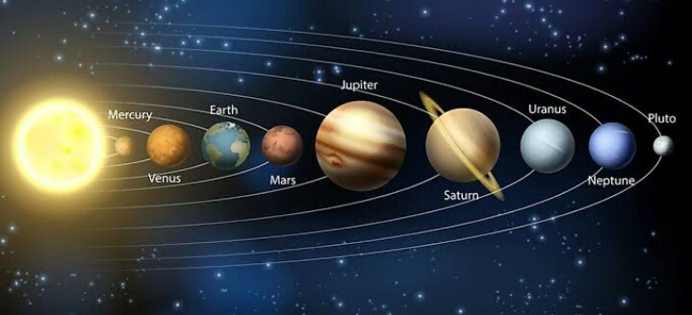
Kepler data
Vinolia Varsha S

Slide 2
Dataset
Dataset name : kepler Data
Dataset link: https://exoplanetarchive.ipac.caltech.edu/cgi-bin/TblView/nph-tblView?app=ExoTbls&config=cumulative

Slide 3
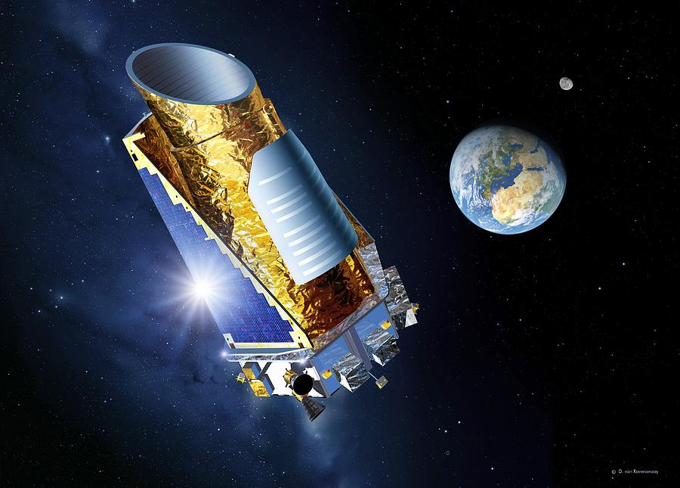
Kepler Mission
The Kepler Mission, a NASA Discovery mission launched on March 6, 2009, was the first space mission dedicated to the search for Earth-sized and smaller planets in the habitable zone of other stars in our neighborhood of the galaxy.
Kepler was a special-purpose spacecraft that precisely measured the light variations from thousands of distant stars, looking for planetary transits.
When a planet passes in front of its parent star, as seen from our solar system, it blocks a small fraction of the light from that star; this is known as a transit.
Searching for transits of distant Earths is like looking for the drop in brightness when a moth flies across a searchlight. Measuring repeated transits, all with a regular period, duration and change in brightness, provides a method for discovering planets and measuring the duration of their orbits—planets the size of Earth and smaller in the habitable zone around other stars similar to our Sun.
Kepler continuously monitored over 100,000 stars similar to our Sun for brightness changes produced by planetary transits.

Slide 4
Kepler Data Product Overview Page
The Kepler project produced a wide range of data products and documentation to assist the community in using data from the mission to help study both exoplanets and other astrophysical areas.
These data range from engineering data on the detectors to lists of planet candidates and includes many of the intermediate data products in the data processing path.
The Kepler Data Product Overview page was created to provide a single location with links to all products and their documentation. There are more than 40 data products listed, which are hosted either at MAST or the NASA Exoplanet Archive.

Slide 5
Problem statement
Kepler data is about the KOI(Kepler Objects of Interest) that is a star observed by the Kepler space telescope that is suspected of hosting one or more transiting planets. KOIs come from a master list of 150,000 stars, which itself is generated from the Kepler Input Catalog (KIC).
In this project we are going to create an ML algorithm to classify the planets as Candidate/False positive/Confirmed etc. based on the column “koi_disposition”.
Using different tuning methods for algorithm.
Finding the best accuracy algorithm.

Slide 6
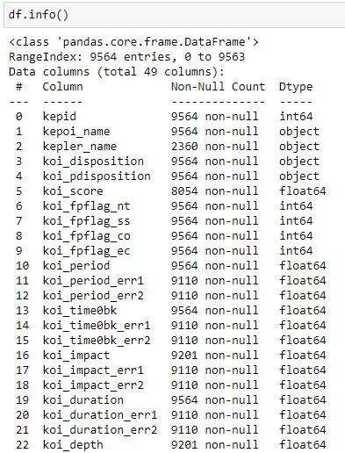
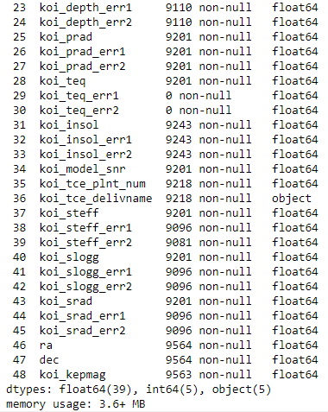
Understanding the data
There is float64(39), int64(5), object(5)
On a total there is 48 column
And we are going to concentrate on the “koi_disposition” column

Slide 7
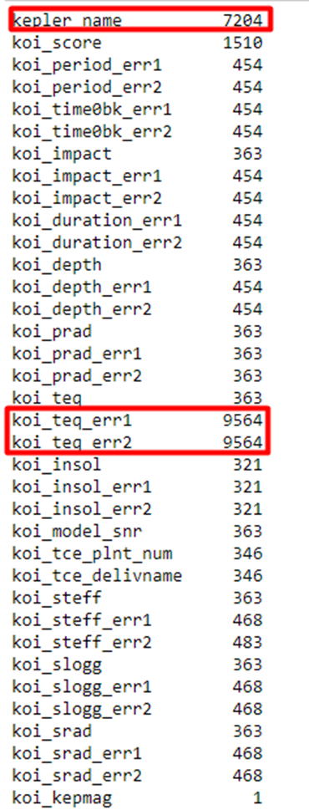
Challenges In The Data
Checking for null values in the data
the column kepler_name, koi_teq_err1 and koi_teq_err2 have the more the 50% of missing values

Slide 8
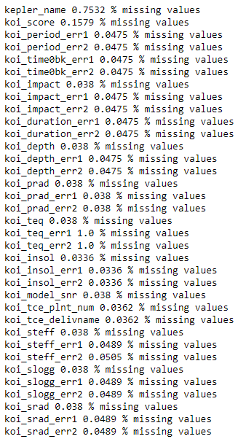
Missing value percentage
This are the missing value in percentage
Next step is to drop all the missing value that is more than 50%

Slide 9
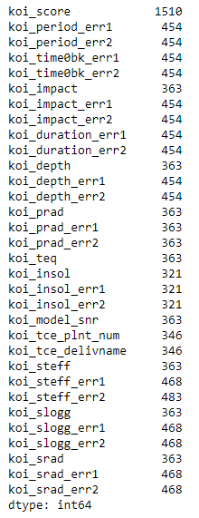
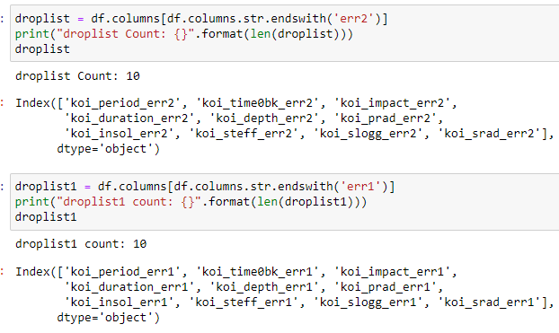
Treating the missing values Action-1
Creating a drop list on the err1 and err2
The err1, err2 is the Uncertainties Columns upper(positive +) and lower(negative -) Transit Properties(Parameters)

Slide 10
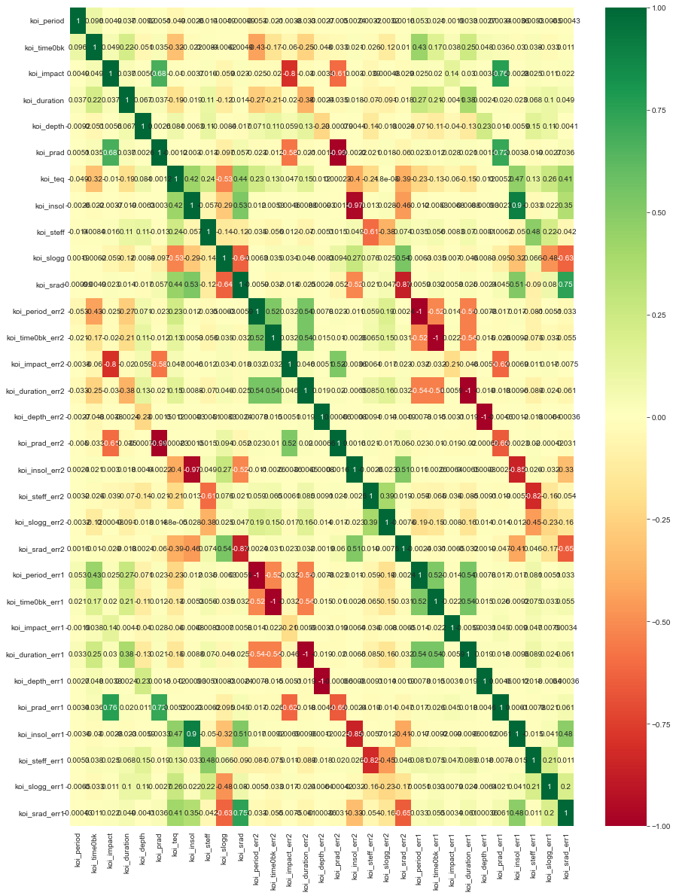
Treating the missing values Action-2
The err1, err2 is the Uncertainties Columns upper(positive +) and lower(negative -) Transit Properties(Parameters)
Scaled planetary parameters combine the dimensionless fit parameters with physical stellar parameters to produce planet characteristics in physical units.
There is a lot of correlation among those err1 and err2 parameters so we are dropping the err1 and err2

Slide 11
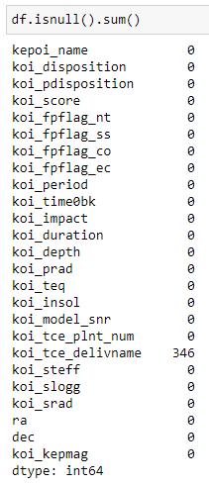
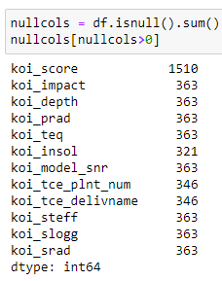
Treating missing values Action-3
We are left out with this columns
Here we are treating the missing values by making it to be median

Slide 12
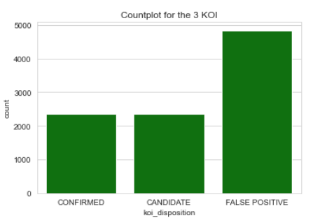
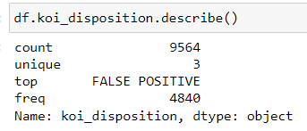
Major finding through EDA 'koi_disposition'
FALSE POSITIVE 4840
CANDIDATE 2366
CONFIRMED 2358

Slide 13
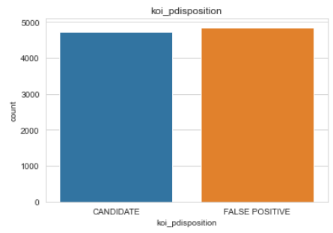
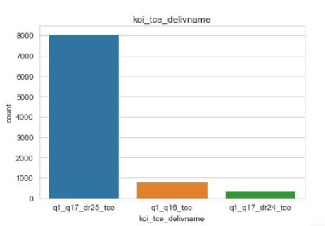
Major finding through EDA Categorical feature
There is three categorical feature kepoi_name, koi_disposition, koi_pdisposition, koi_tce_delivname
Value counts of the koi_pdisposition column is
FALSE POSITIVE - 4847
CANDIDATE - 4717
Value counts of the koi_tce_delivname column is
q1_q17_dr25_tce - 8054
q1_q16_tce - 796
q1_q17_dr24_tce - 368

Slide 14
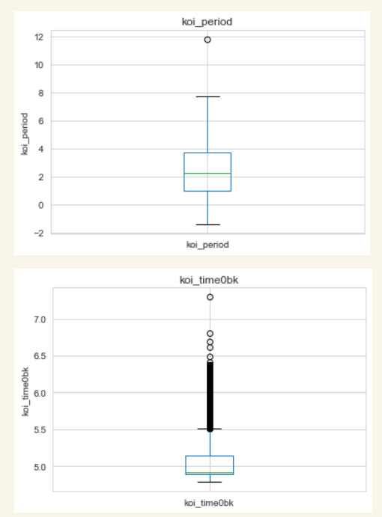
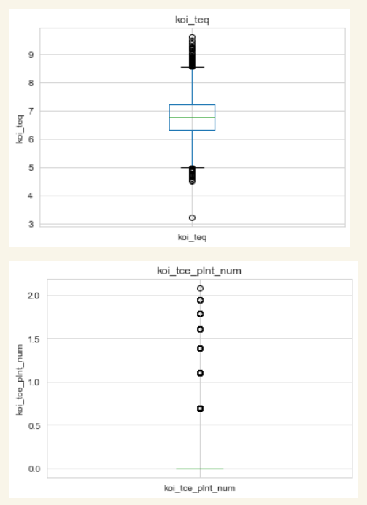
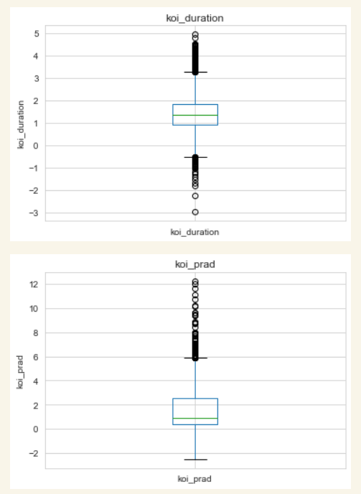
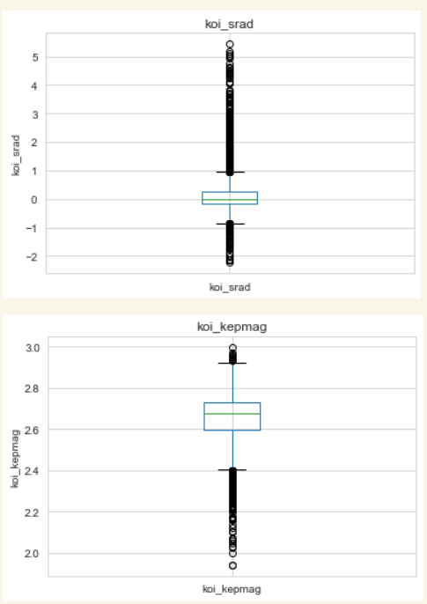
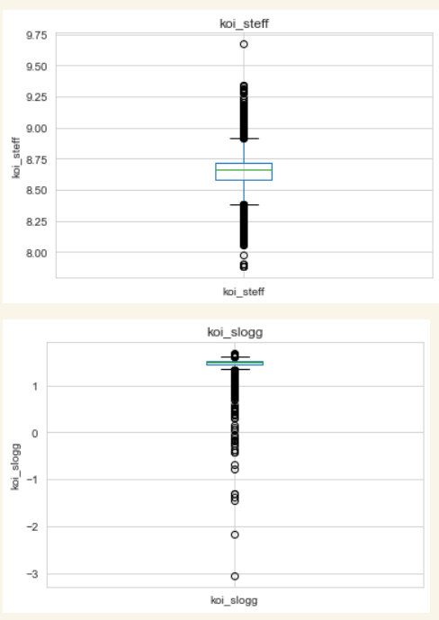
Major finding through EDA Outliers

Slide 15
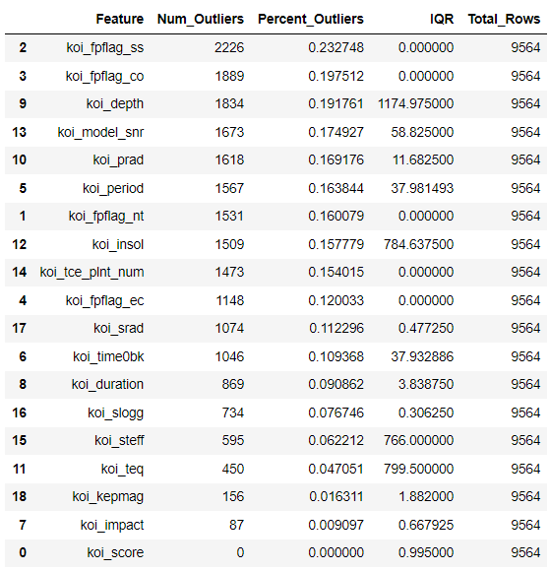
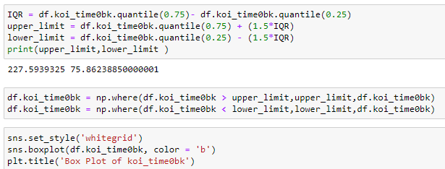
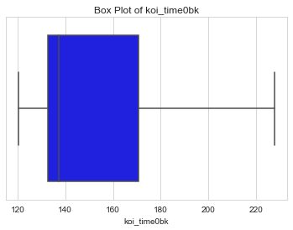
Data understand and cleaning Action-1
As we can see there are many outliers in the data so we should treat it one by one
Treating the outliers according to the upper limit and lower limit that is the IQR

Slide 16
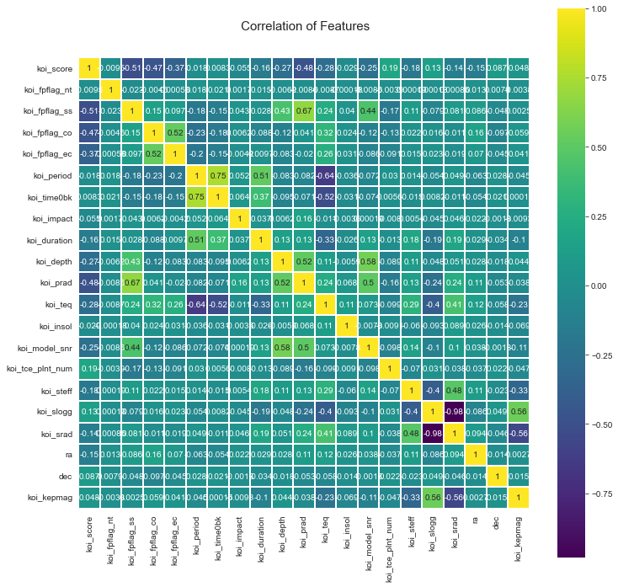
CORRELATION MATRIX
As seen in the correlation plot, we can conclude
koi_time0bk has a high correlation with koi_period
koi_prad and koi_fpflag_ss have a high correlation
We will try to train model after dropping the features of koi_time0bk

Slide 17
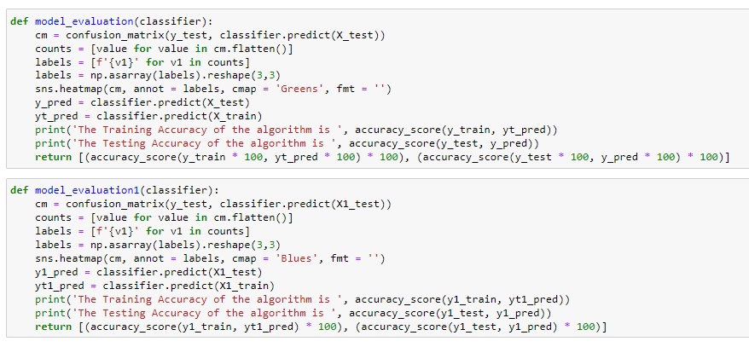
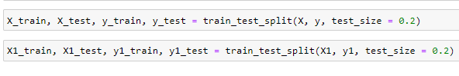
Model selection Functions for Model Evaluation
All the models will be evaluated on 2 datasets.
The first dataset is the one where no column is dropped and the confusion matrix will be plotted in Green Color.
The second dataset is the one where some columns are dropped to try improve the accuracy and the confusion matrix for this data will be plotted in Blue Color

Slide 18
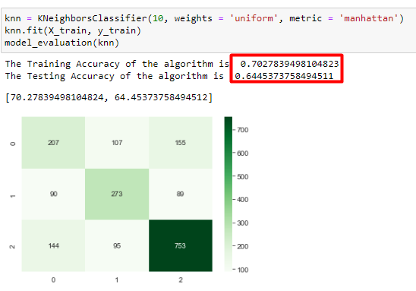
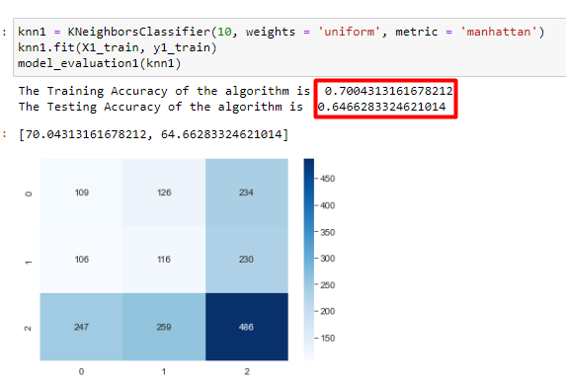
K Nearest Neighbours

Slide 19
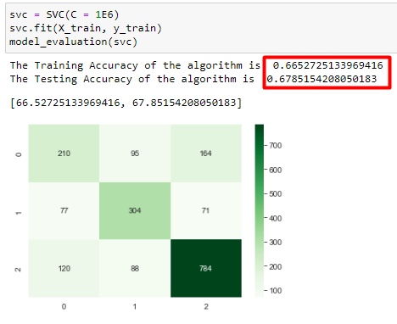
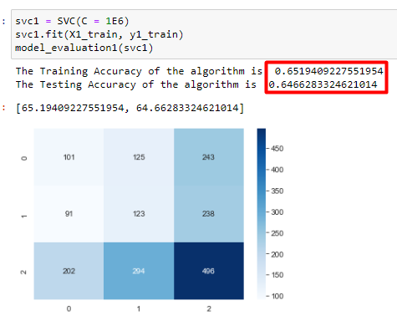
Support Vector Classifier

Slide 20
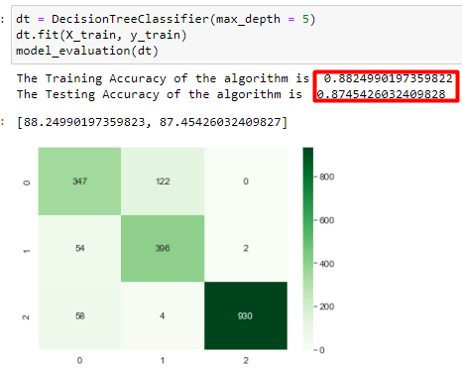
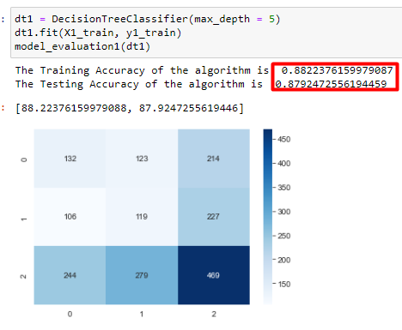
Decision Tree Classifier

Slide 21
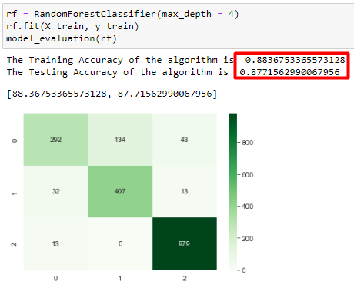
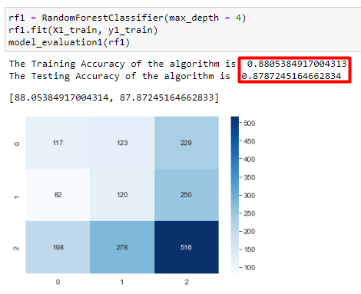
Random Forest Classifier

Slide 22
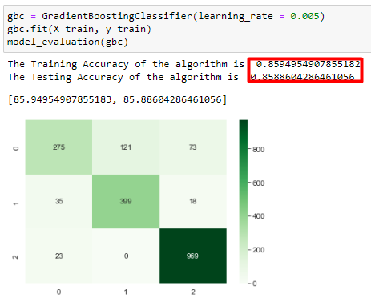
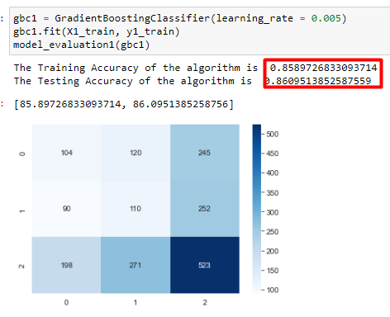
Gradient Boosting Classifier

Slide 23
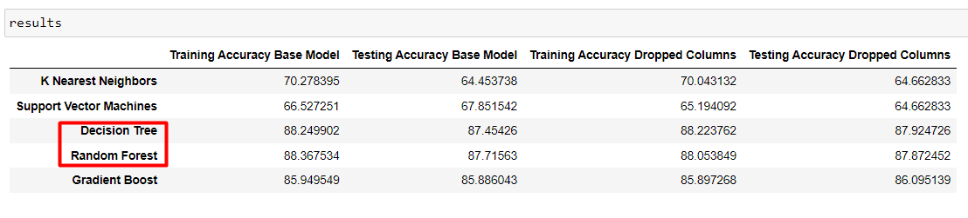
Results
There is a good accuracy in Decision Tree and Random Forest in the training and the testing based model as well in the dropped columns
Lets apply some tunning methods for more efficiency

Slide 24
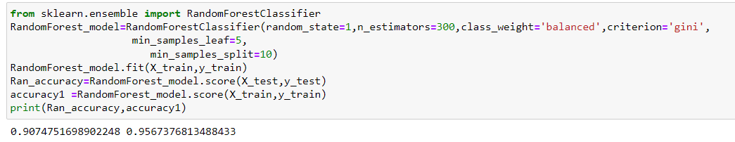
Tuning Hyperparameters
By apply Tuning Hyperparameters to random forest we get a accuracy of 0.9074751698902248 0.9567376813488433
Random Forest tuning Hyperparameters we’ll be Looking at: max_depth, min_sample_split, max_leaf_nodes, min_samples_leaf, n_estimators, max_sample (bootstrap sample), max_features,

Slide 25
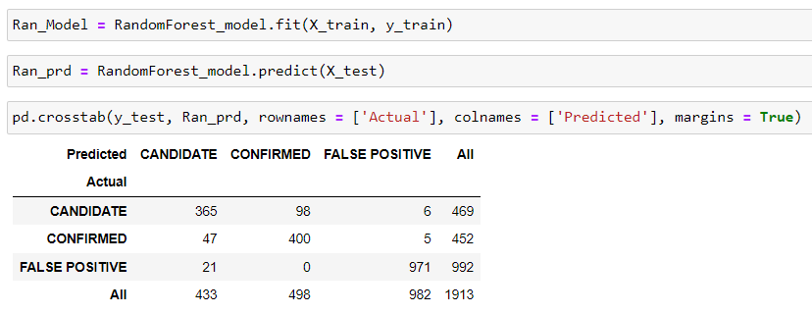
Crosstab

Slide 26
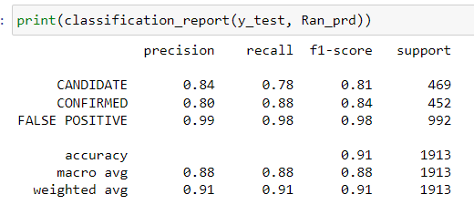
Classification report
We can absorb the classification report of the precision and recall and f1 score matrix's

Slide 27
Conclusion
I tried to improve accuracy by dropping columns, but it did not affect the accuracy much.
I have achieved good accuracies with Decision Tree, Gradient Boost and Random Forest Algorithms
Among all other algorithms Random forest gives higher accuracy so I've chosen Random forest in this model.
Random Forest tuning Hyperparameters we’ll be Looking at: max_depth, min_sample_split, max_leaf_nodes, min_samples_leaf, n_estimators, max_sample (bootstrap sample), max_features,
I did consider other Algorithm like Decision Tree and Gradient Boost but I found it unsatisfactory
After tuning Random Forest the Training accuracy 95.67, Testing accuracy 90.74
Recall and F1_score are the metrics used to evaluate the model

Slide 28
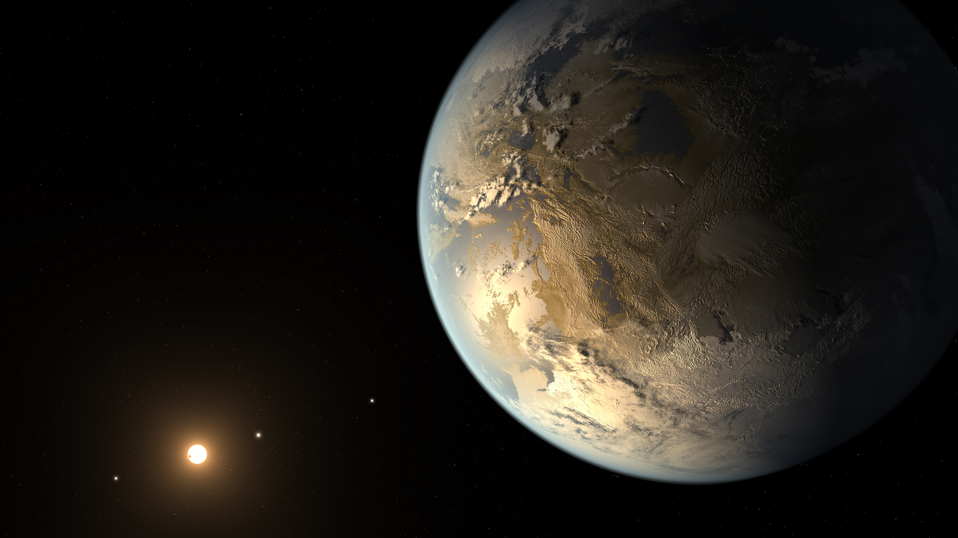
THANK YOU
FOR
REVIEWING
MY WORK

